Slide 1
File and Data Sharing in the Near Field
Rich Marino
Notes:
Let’s talk about file sharing in the near field.
If a few of us are nearby, it should be really easy to transfer a file…but this is surprisingly difficult.

Slide 2
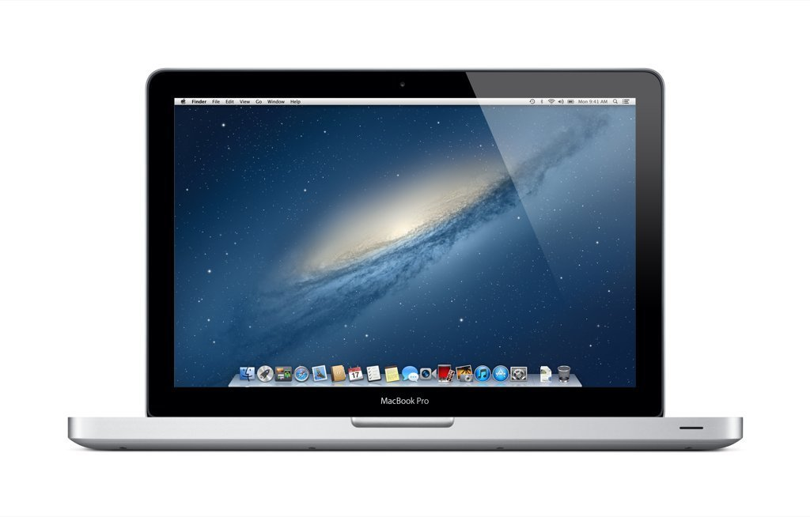

An informal meeting…
Notes:
informal meeting: Business, or family, friends, or otherwise.
Working on a class project. Don’t know the other person so well. I need to give him some files.
How?

Slide 3
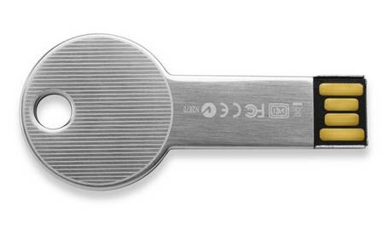
An informal meeting…
Notes:
Flash Drive – bit unwieldy, but okay for only 2 people. More is bad.

Slide 4

An informal meeting…
Notes:
Email – Its okay, requires everyone check, and internet.

Slide 5



An informal meeting…
Notes:
Dropbox – OK if we both have a shared folder. Small hassle if no shared folder, more hassle if no account.
78/ SkyDrive – same, but share an account with other services, slight advantage.

Slide 6

An informal meeting…
Notes:
Skype – if everyone has an account, great. Lot of people = pay. Can send files on LAN to help speed.

Slide 7

An informal meeting…
Notes:
Rapidshare – umm…no

Slide 8

An informal meeting…
Notes:
Instant Messenger Programs – may work if everyone is on one network, but…

Slide 9

An informal meeting…
Notes:
Facebook Messenger - …is probably better. Esp. if everyone is on FB together.

Slide 10


An informal meeting…
Notes:
Web Server – technical know how, and only one way. Local web server okay…network issues, or FTP up to a remote server…or

Slide 11

An informal meeting…
Notes:
FTP Server -- …use an FTP Server.
Others can upload
But still need to install and network funny.

Slide 12

An informal meeting…
Notes:
Windows SMB – Make a share, everyone connect. Not easy for most people, can be treacherous in a public environment.

Slide 13

An informal meeting…
Notes:
Bluetooth OBEX – easier, but slow, and a PITA to make work. Bad compatibility?

Slide 14

An informal meeting…
Notes:
AirDrop – There actually is a good technology for this…AirDrop. But it only works on Apple products…and not even between different kinds at present.

Slide 15



AirDrop
Notes:
AirDrop works very well, if you can use it.
Special folder in Finder that shows other devices. Drag files.
Other user prompted.
Then file transferred (without internet)

Slide 16
?
Notes:
Airdrop is nice with Macs, (and iOS 7 devices), but its treacherous to do it with anything else…

Slide 17


Difficulties with NFC and Wi-Fi Direct
The range is very low – several centimeters.
Wi-Fi Direct is too non-standard to be useful at present.
Notes:
Project quite difficult, and NFC proves inadequate for a blast transfer
--too low range.
--wi-fi direct unstable

Slide 18
New Process
Internet service design will be adjusted.
Web service generates file ID
File ID entered on receiving devices
If the client is on the same LAN as the sender, the file is transferred in network via UDP Multicast.
If the client is not accessible, the file will be uploaded to the web server, and the client will download it.
File IDs will be recycled periodically (every 24 hours at least).
Notes:
So, we should be able to send files nearby without difficulty, and without dependence on the Internet.

Slide 19
New Process
Client Net Accessible?
Start
Web Service: Generate File ID
Client: Enter File ID
Send file via UDP Multicast
Upload file to Web; Client downloads
End
Notes:
-Web Service Redesign
-Process of sending file: generate ID,

Slide 20
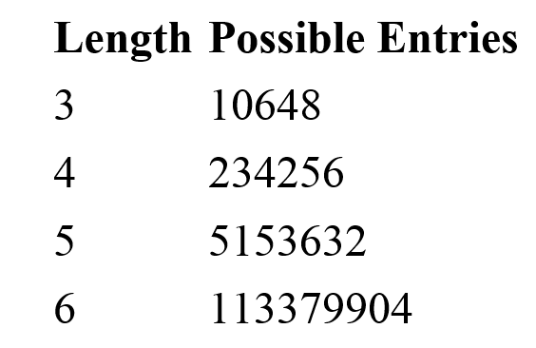
File IDs
Short, case insensitive
234679CDFGHJKMPQRTVWXY
Notes:
-The characters that will be used in file IDs will be limited to avoid ambiguity and confusion.
-File IDs will also be short (5 characters online, 4 offline) and case insensitive.

Slide 21
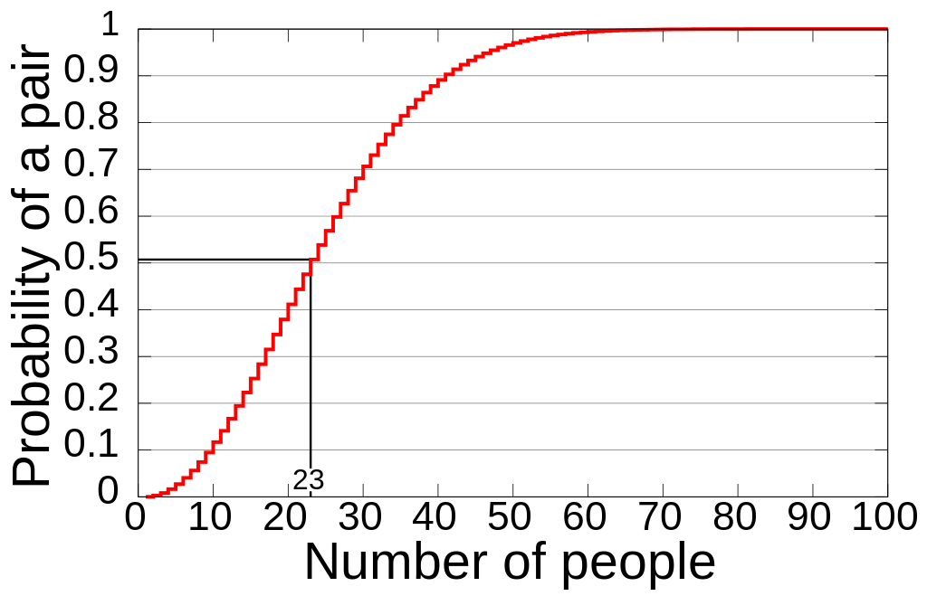
File IDs – Birthday Paradox
Notes:
-Birthday Paradox – within a surprisingly small pool, two random numbers will collide.
-File ID collisions – mitigated by short lifetime (several hours to a day at most)

Slide 22
Final Result
Web Service (meeting new specifications)
Can be used with just web browser, if desired
Application that runs on at least one platform (Windows initially), to facilitate transfers.
A method of transferring the file ID without typing it.
Stretch Goals:
Cross-platform (Android, iOS, Mac, WinPho)

Slide 23
Ultimate Goal
Provide a means of transferring files (in an adhoc manner) that’s quicker and easier than using existing technologies
DropBox/Google Drive/SkyDrive, USB Drive, E-mail, etc.

Slide 24


Slide 25
Evaluation
http://rm.vg/f
Evaluation can be seen at the above URL.
Use:
Enter a room.
Drag a file into the box to upload
Click on a file and click download to download.
Note that this system currently does not purge files after a certain amount of time

